Slide 1
SQL
Structured Query Language
Under Guidance
Jaffrin Sir
(Besant Technology)
Presented By
Nethravathi K Hangarki

Slide 2
SQL
Structured Query Language(SQL) is a
Programming language for string & processing information in a relational database. A Relational database stores information in tabular form, with rows & columns representing different data attributes and the various relationship b/w the data values.

Slide 3

sky
How does sql work?
SQL Query
Query Language
Processor
Parser + Optimizer
DBMS Engine
File Manager+ Transaction Manager
Physical Database

Slide 4






ADVANTAGE OF SQL
Easy to
learn
Create several
views
Easy syntax
Portable
Interactive language

Slide 5

Project Name
SPOTIFY PLAYLIST

Slide 6

SPOTIFY PLAYLIST
Spotify is a music streaming
platfrom that allows users to listen
songs from various genres.
A music streaming service is a
type of streaming media service
that focuses primarily on music,
and sometimes other forms of
digital audio content such as
podcasts.
Spotify was the largest music
streaming service in the world as
of the second quarter of 2021.
A music streaming platform
database can store information
about songs, albums, artists, genres, and other related data.

Slide 7
Entity Relationship Diagram
Artist Table
Album Table
Genre Table
User Table

Slide 8
Entity Relationship Diagram
Artist_id int Foreign Key
Song_id int primary key
Song_name varchar(50)
Release_year int
Album_Table
Artist_id int primary key
Artist_name varchar(50)
Artist_Table
User_id int primary key
User_name varchar(50)
Genre_id int foreign key
Preferred genre varchar(50)
User_Table
Genre_id int Primary key
Artist_id int Foreign key
Genre_name varchar(50)
Genre_Table

Slide 9
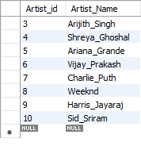
Artist_Table

Slide 10
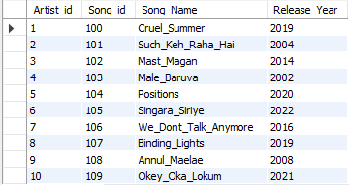
Albums_Table

Slide 11
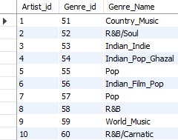
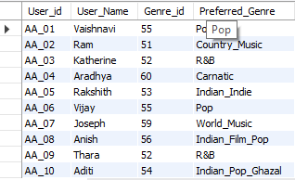
Genre_Table
User_Table

Slide 12
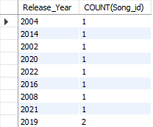
OUTPUT:
Write a query to list of songs
released each year
SELECT Release_Year,COUNT(Song_id)
FROM Album_Table GROUP BY
Release_Year ORDER BY COUNT(Song_id);

Slide 13
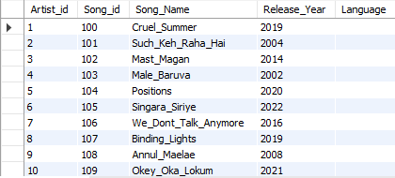
Write a query to add a Language
column in an Album_Table
OUTPUT:
ALTER table Album_Table
ADD COLUMN Language VARCHAR(50) NOT NULL;

Slide 14
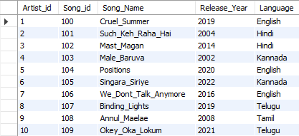
Write a query to update an information
in a Language column in an Album_Table
Update Album_Table set Language = case
when Song_Name='Cruel_Summer' then 'English‘
when Song_Name='Such_Keh_Raha_Hai' then ‘Hindi’
when Song_Name='Mast_Magan' then 'Hindi‘
when Song_Name='Male_Baruva' then 'Kannada‘
when Song_Name='Positions' then 'English‘
when Song_Name='Singara_Siriye' then 'Kannada‘
when Song_Name='We_Dont_Talk_Anymore' then ‘English’
when Song_Name='Blinding_Lights' then 'English‘
when Song_Name='Annul_Maelae' then 'Tamil‘
else 'Telugu' end;
OUTPUT:

Slide 15

Write a query to extract user details who have
character ‘a’ at 3rd position of their name
SELECT User_Name FROM User_Table WHERE
User_Name LIKE ‘__a%’;
OUTPUT:

Slide 16
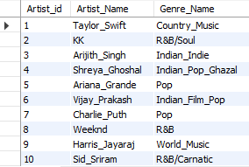
Write a query to list Artist names
for each genre
SELECT Artist_Table.Artist_id,Artist_Table.Artist_Name,
Genre_Table.Genre_Name FROM Artist_Table JOIN
Genre_Table ON Artist_Table.Artist_id=Genre_Table.Artist_id;
OUTPUT:

Slide 17

Write a query to list English songs released after
2015
SELECT Album_Table.Release_Year,Album_Table.Song_Name,
Artist_Table.Artist_Name FROM Album_table JOIN Artist_Table ON
Artist_Table.Artist_id=Album_Table.Artist_id WHERE
Release_Year>2015 AND Language=‘English’ ORDER BY
Release_Year ASC;
OUTPUT:

Slide 18
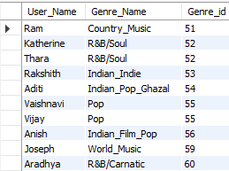
Write a query to list User_Name for
their Preferred_Genre
SELECT User_Table.User_Name ,Genre_Table.Genre_Name,
Genre_Table.Genre_id FROM User_Table JOIN Genre_Table
ON User_Table.Genre_id=Genre_Table.Genre_id ORDER BY
Genre_id ASC;
OUTPUT:

Slide 19

Write a query to extract the User_Name who
listens to the Genre ’Pop’
SELECT User_Table.User_Name,Genre_Table.Genre_id,
Genre_Table.Genre_id FROM User_Table JOIN Genre_Table
ON User_Table.Genre_id=Genre_Table.Genre_id AND
Genre_Name=‘Pop’ ORDER BY Genre_id ASC ;
OUTPUT:

Slide 20

THANK YOU

